Slide 1
Reddit Thread Classification: r/Relationships and r/BreakUps
by: Mia Martin

Slide 2

How do I (28f) break up with someone when I’m their (31m) everything?
I used to hope that you’d bring me flowers. Now I plant my own.

Slide 3
Agenda: Data Science Process
Define the problem
Gather the data
Explore the data
Model with data
Evaluate the model
Answer the problem

Slide 4
1. Define the Problem
Can reddit posts from r/Relationship and r/BreakUps subreddit threads be classified into their respective thread based on their title?

Slide 5
2. Gather the Data
Subreddit choices
Number of posts scraped

Slide 6
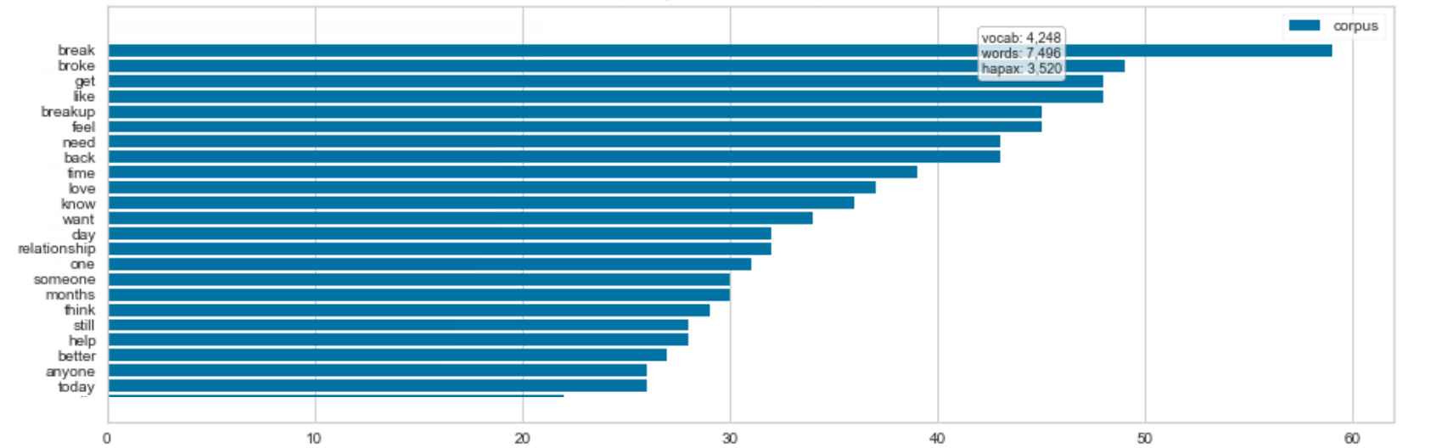
3. Explore the Data
r/BreakUps Frequency Distribution of Top 20 Tokens
Word in title
Word frequency

Slide 7
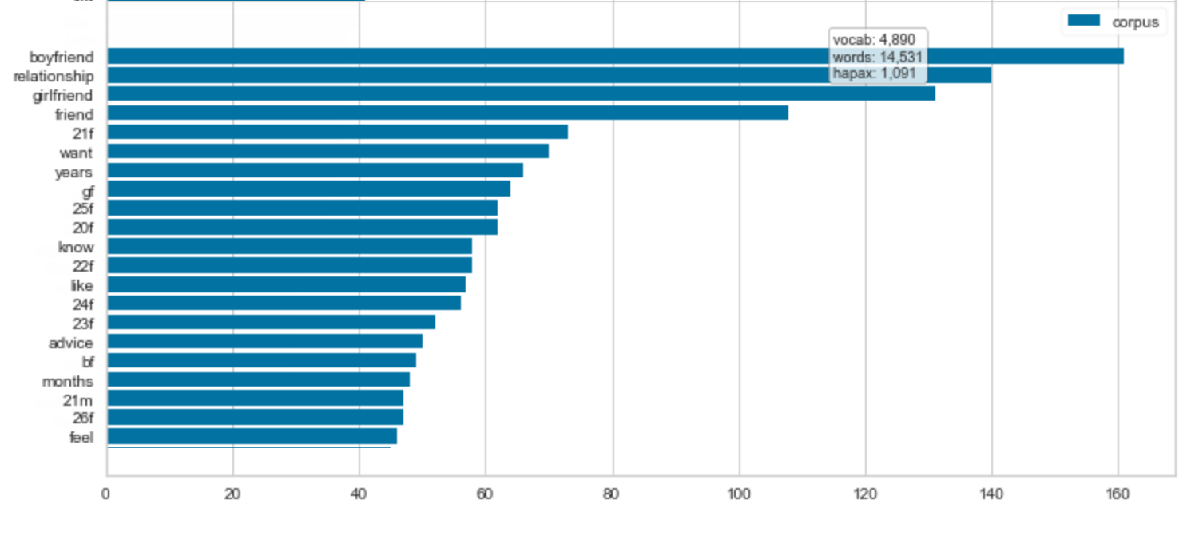
3. Explore the Data
r/Relationships Frequency Distribution of Top 20 Tokens
Word in title
Word frequency
Word frequency

Slide 8
They always come back

Slide 9
4. Model with Data
Vectorizer
Hashingvectorizer
Countvectorizer
Model
Multinomial Naïve Bayes
Bernouli Naïve Bayes
Logistic Regression

Slide 10
5. Evaluate the Model
Vectorizer
Hashingvectorizer – 52% on test
Countvectorizer – See below
Model
Multinomial Naïve Bayes – 86% on test
Bernouli Naïve Bayes – 91% on test??
Logistic Regression – 94% on test!!

Slide 11
6. Answer the Problem
Title can be used to predict classification of subreddit thread between r/Relationships and r/BreakUps with 94% accuracy.

Slide 12
6. Answer the Problem
r/BreakUps Titles
Storytelling
More “want” and “feel” language
r/Relationships Titles
Straight to the point
More “gf” and “bf” language
Age + Gender

Slide 13
How do I (28f) break up with someone when I’m their (31m) everything?
I used to hope that you’d bring me flowers. Now I plant my own.

Slide 14
Questions?

